Slide 1
Paper Review: Using methods from machine learning to evaluate behavioral models of choice under risk and ambiguity
Ming-Han Li(黎明翰)

Slide 2
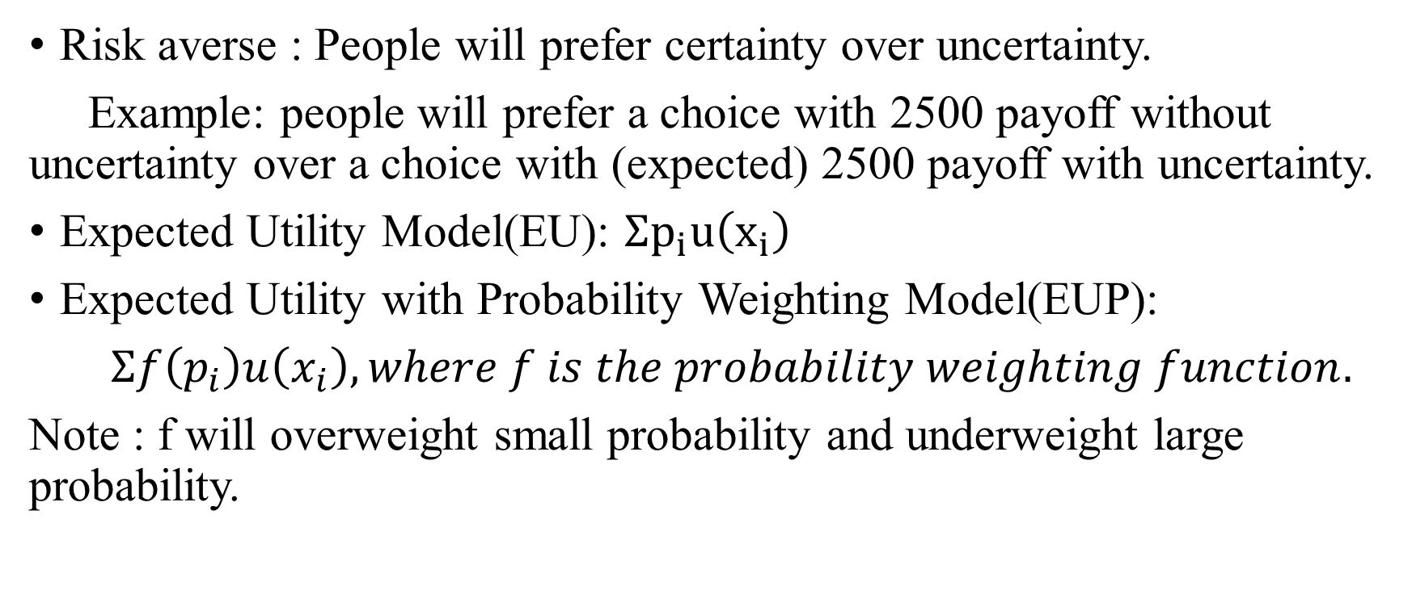
Choice under Risk : Preliminaries
Risk averse : People will prefer certainty over uncertainty.
Example: people will prefer a choice with 2500 payoff without uncertainty over a choice with (expected) 2500 payoff with uncertainty.
Expected Utility Model(EU): $Σp_{i}u\left(x_{i}\right)$
Expected Utility with Probability Weighting Model(EUP):
$Σf\left(p_{i}\right)u\left(x_{i}\right), where f is the probability weighting function.$
Note : f will overweight small probability and underweight large probability.

Slide 3
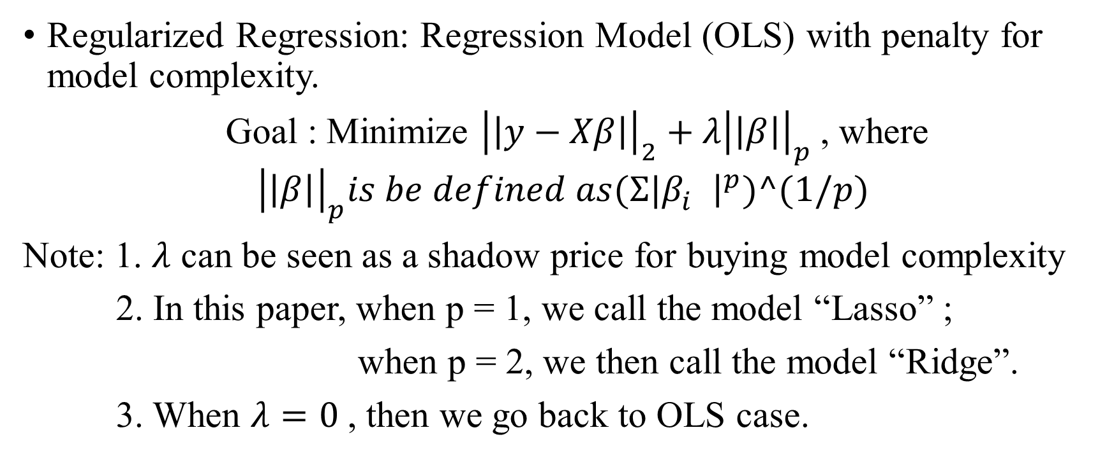
Choice under Risk : Preliminaries
Regularized Regression: Regression Model (OLS) with penalty for model complexity.
Goal : Minimize ${\left|\left|y−Xβ\right|\right|}_{2}+λ{\left|\left|β\right|\right|}_{p}$, where ${\left|\left|β\right|\right|}_{p}is be defined as{(Σ|β}_{i}^{}{\left.​\right|}^{p})^(1/p)$
Note: 1. $λ$ can be seen as a shadow price for buying model complexity
2. In this paper, when p = 1, we call the model “Lasso” ;
when p = 2, we then call the model “Ridge”.
3. When $λ=0$, then we go back to OLS case.

Slide 4
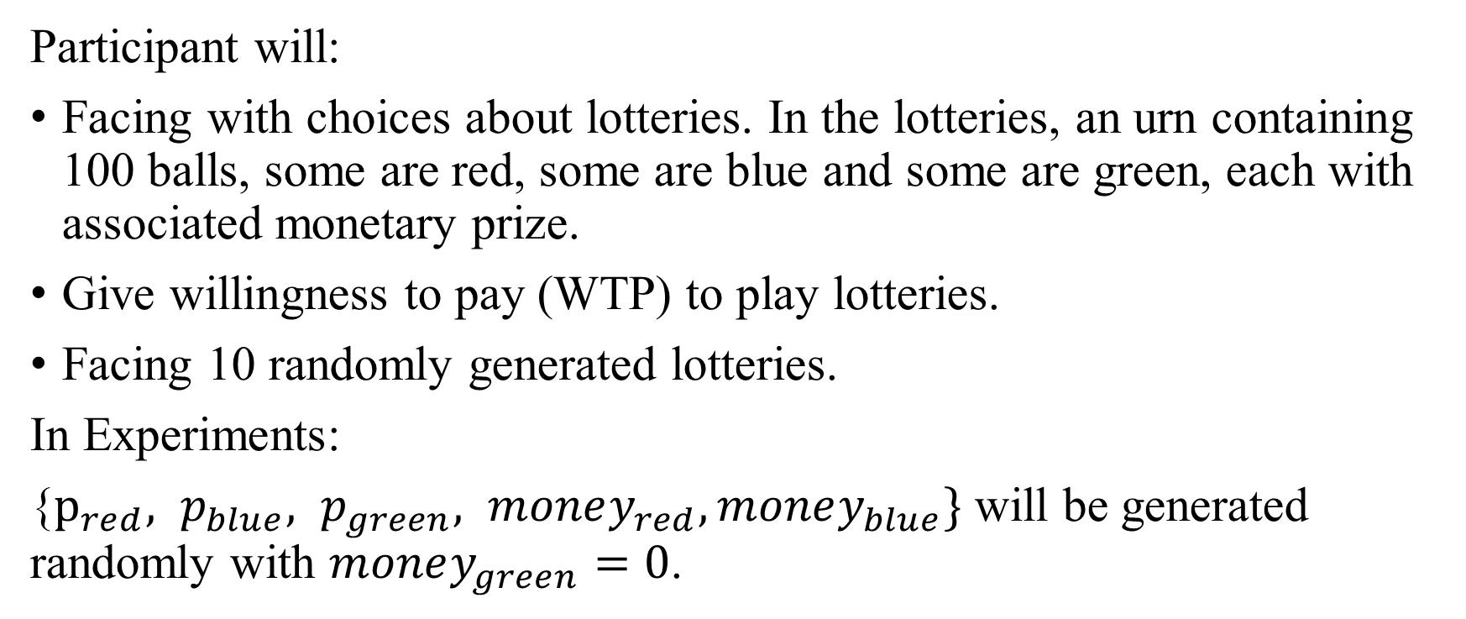
Choice under Risk : Experimental Design
Participant will:
Facing with choices about lotteries. In the lotteries, an urn containing 100 balls, some are red, some are blue and some are green, each with associated monetary prize.
Give willingness to pay (WTP) to play lotteries.
Facing 10 randomly generated lotteries.
In Experiments:
{$p_{red}, p_{blue}, p_{green}, money_{red}, money_{blue}\}$ will be generated randomly with $money_{green}=0$.

Slide 5
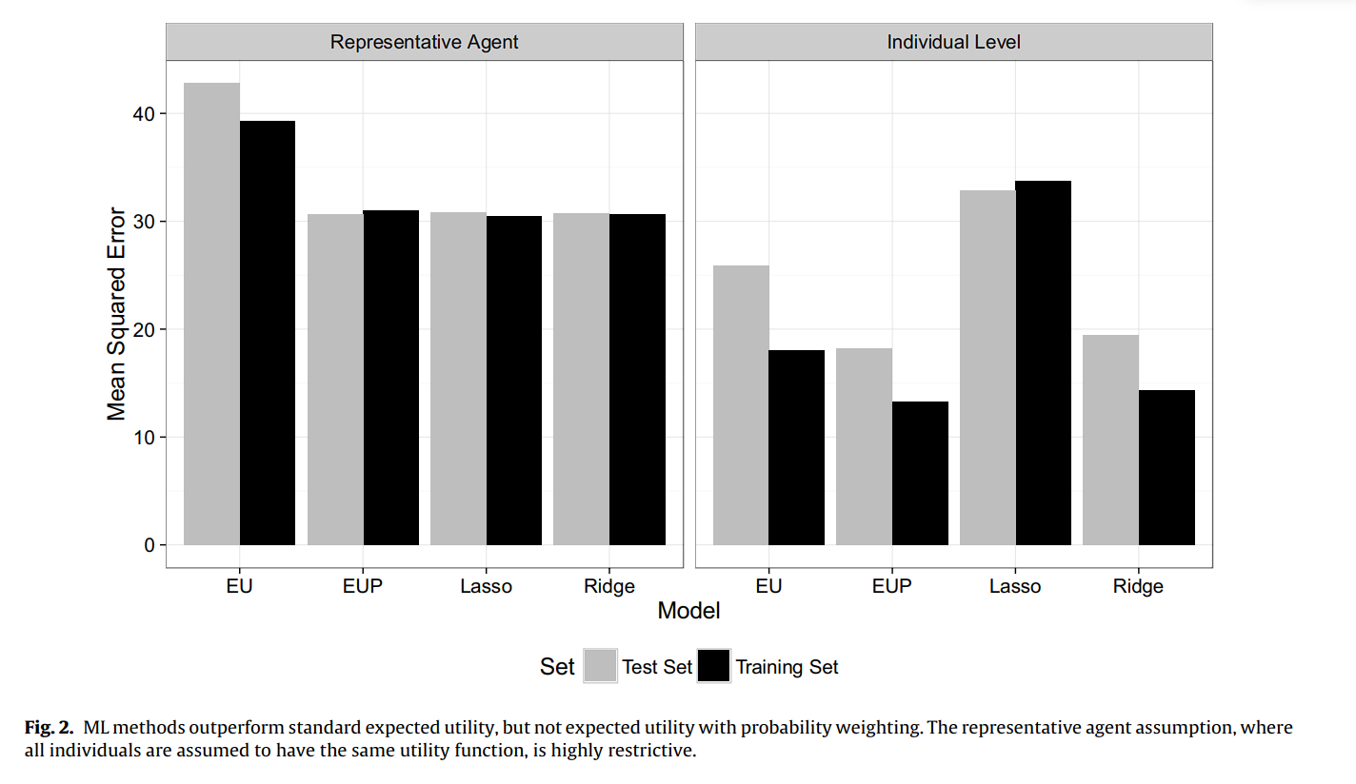
Choice under Risk : Results

Slide 6
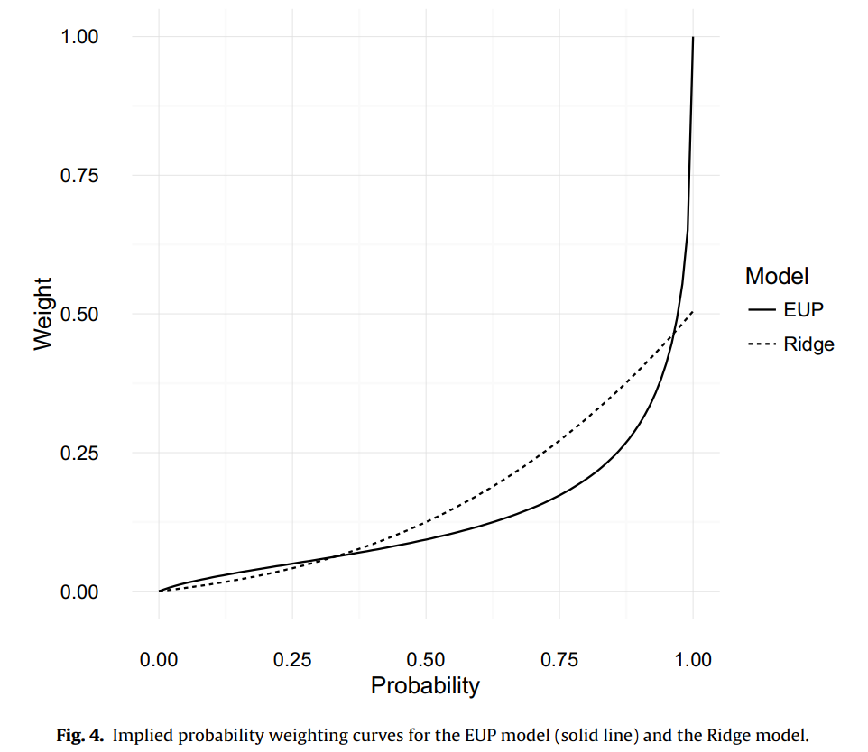
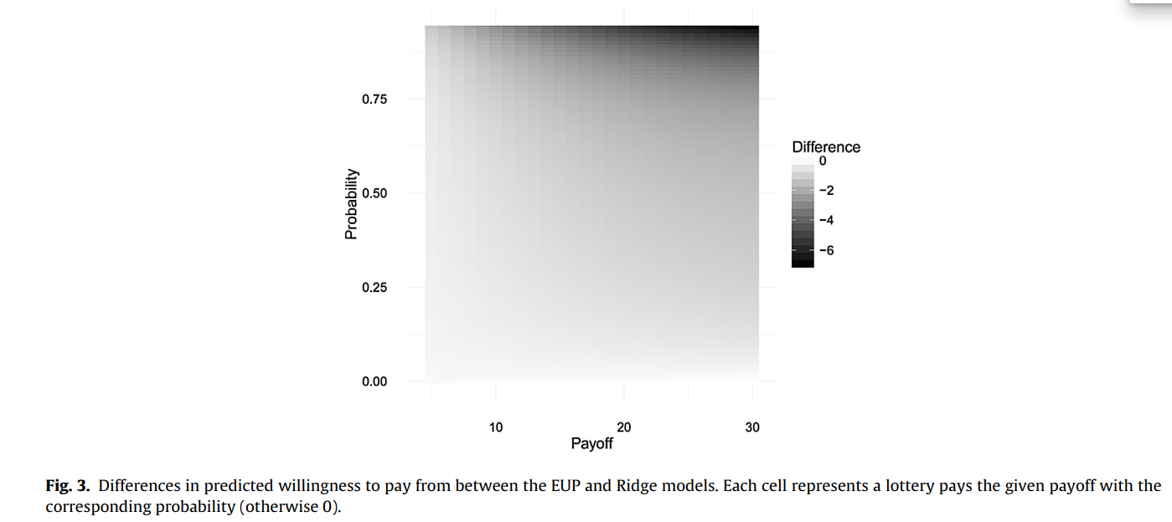
Choice under Risk : Opening the Black Box
Two possible explanations:
ML “re-discovers” EUP.
ML learns some function which is very different from EUP but yields the same prediction error.
Consider lotteries of the form “ win X dollar with probability p “

Slide 7
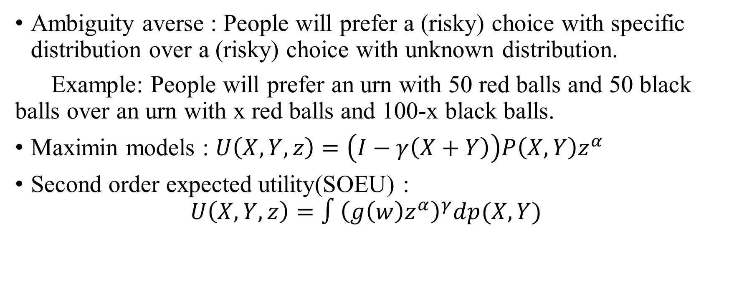
Choice under Ambiguity : Preliminaries
Ambiguity averse : People will prefer a (risky) choice with specific distribution over a (risky) choice with unknown distribution.
Example: People will prefer an urn with 50 red balls and 50 black balls over an urn with x red balls and 100-x black balls.
Maximin models : $U\left(X,Y,z\right)=\left(I−γ\left(X+Y\right)\right)P\left(X,Y\right)z^{α}$
Second order expected utility(SOEU) :
$$U\left(X,Y,z\right)=∫{\left(g\left(w\right)z^{α}\right)}^{γ}dp(X,Y)$$

Slide 8
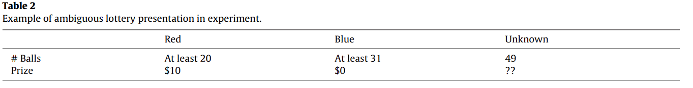
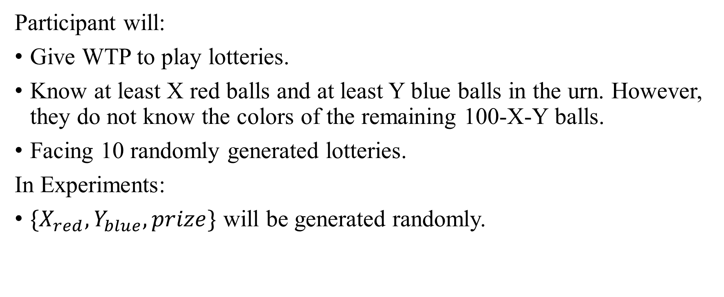
Choice under Ambiguity : Experimental Design
Participant will:
Give WTP to play lotteries.
Know at least X red balls and at least Y blue balls in the urn. However, they do not know the colors of the remaining 100-X-Y balls.
Facing 10 randomly generated lotteries.
In Experiments:
$\{X_{red}, Y_{blue}, prize\}$ will be generated randomly.

Slide 9
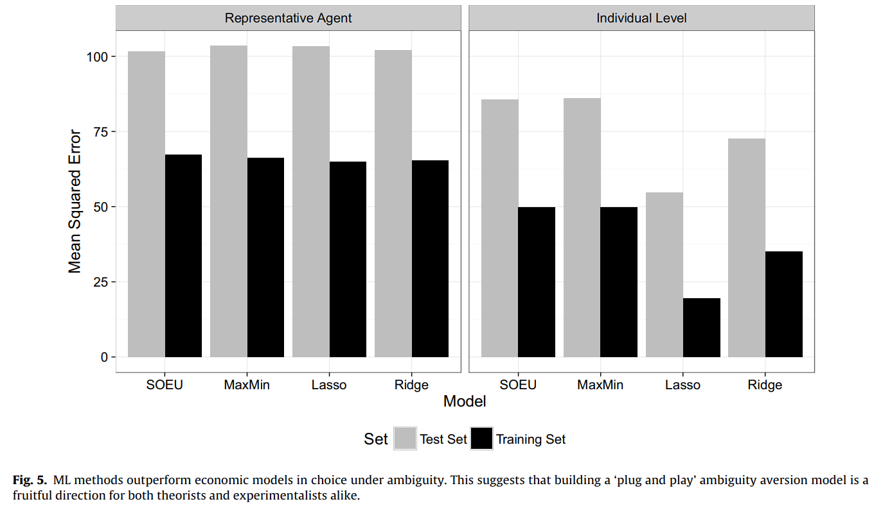
Choice under Ambiguity : Results

Slide 10
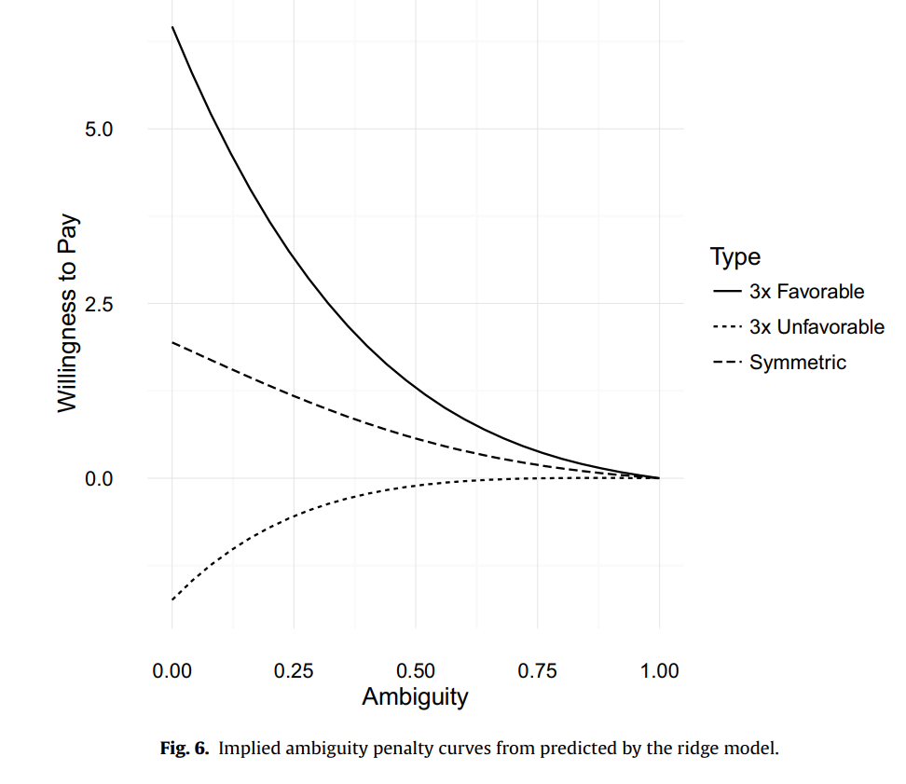
Choice under Ambiguity : Opening the black box
Ample room for the development of a simple model
Favorable information should be weighted more heavily than unfavorable information.(Peysakhovich and Karmarkar 2015)

Slide 11
Paper Review: What can the demand analyst learn from machine learning?
Ming-Han Li(黎明翰)

Slide 12
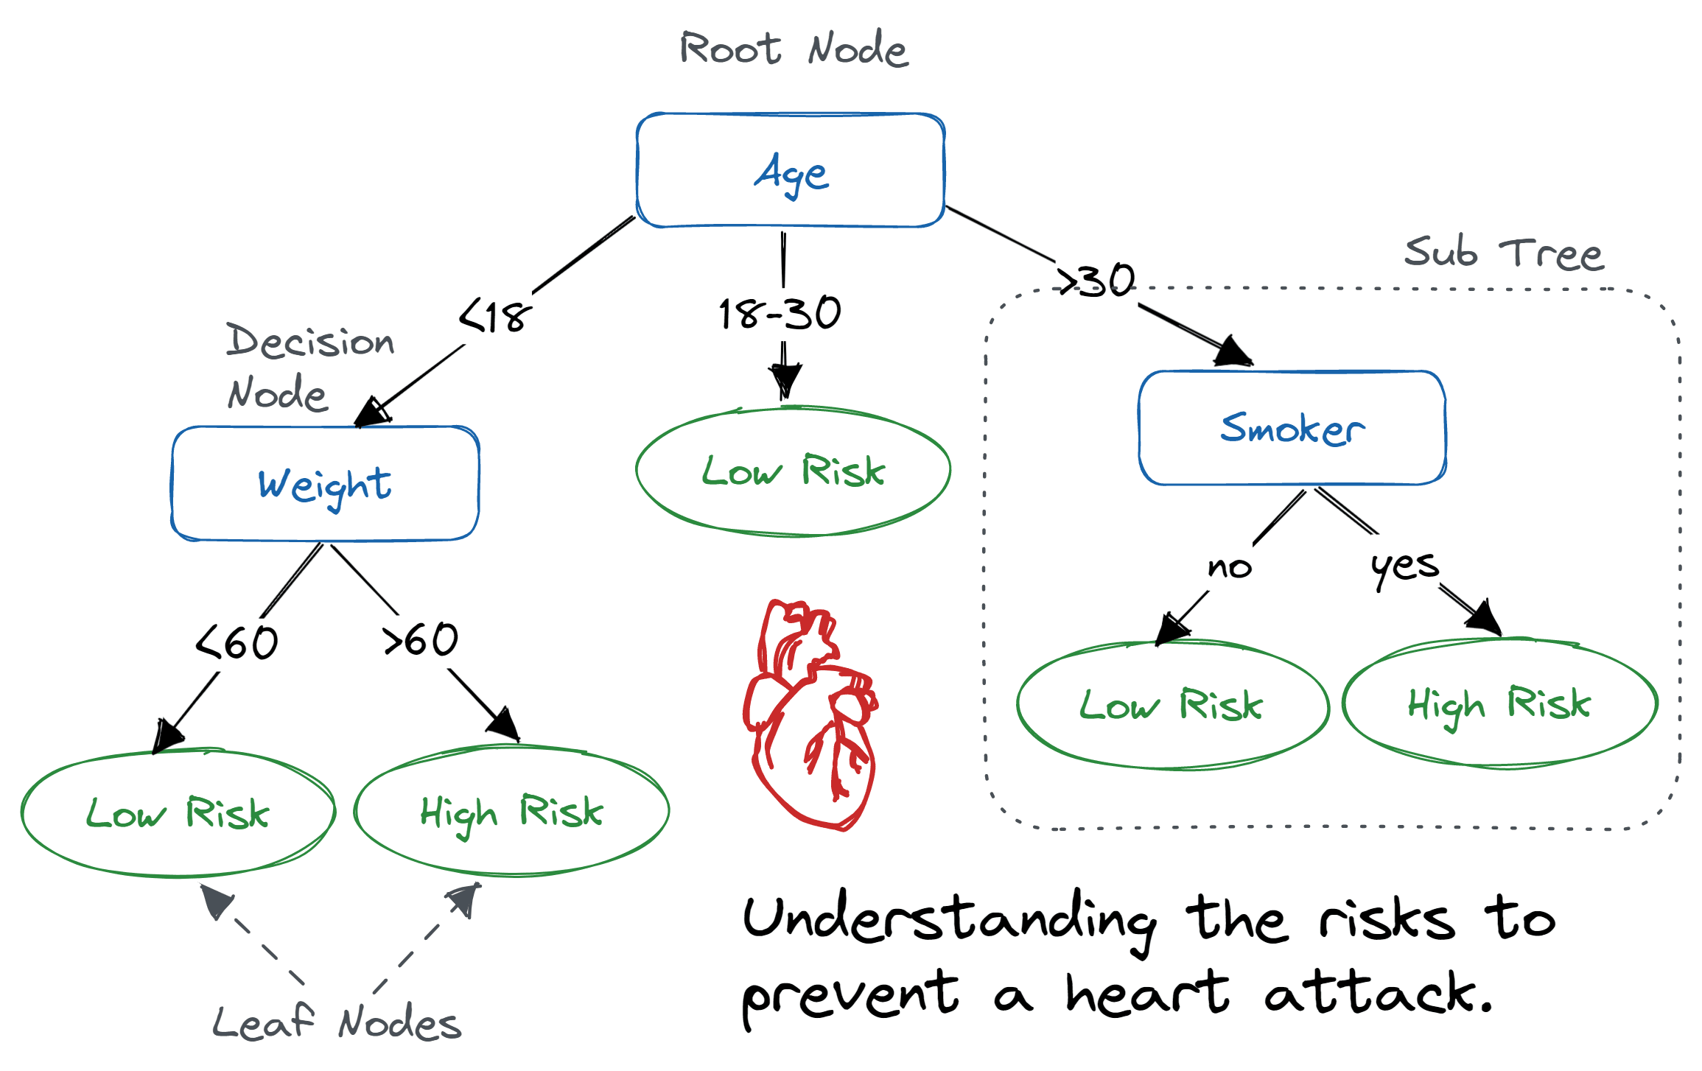
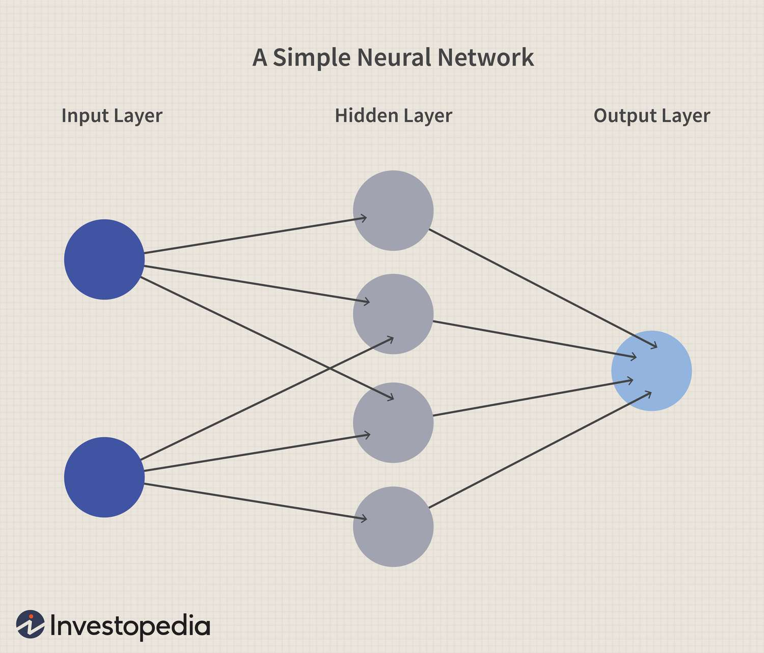
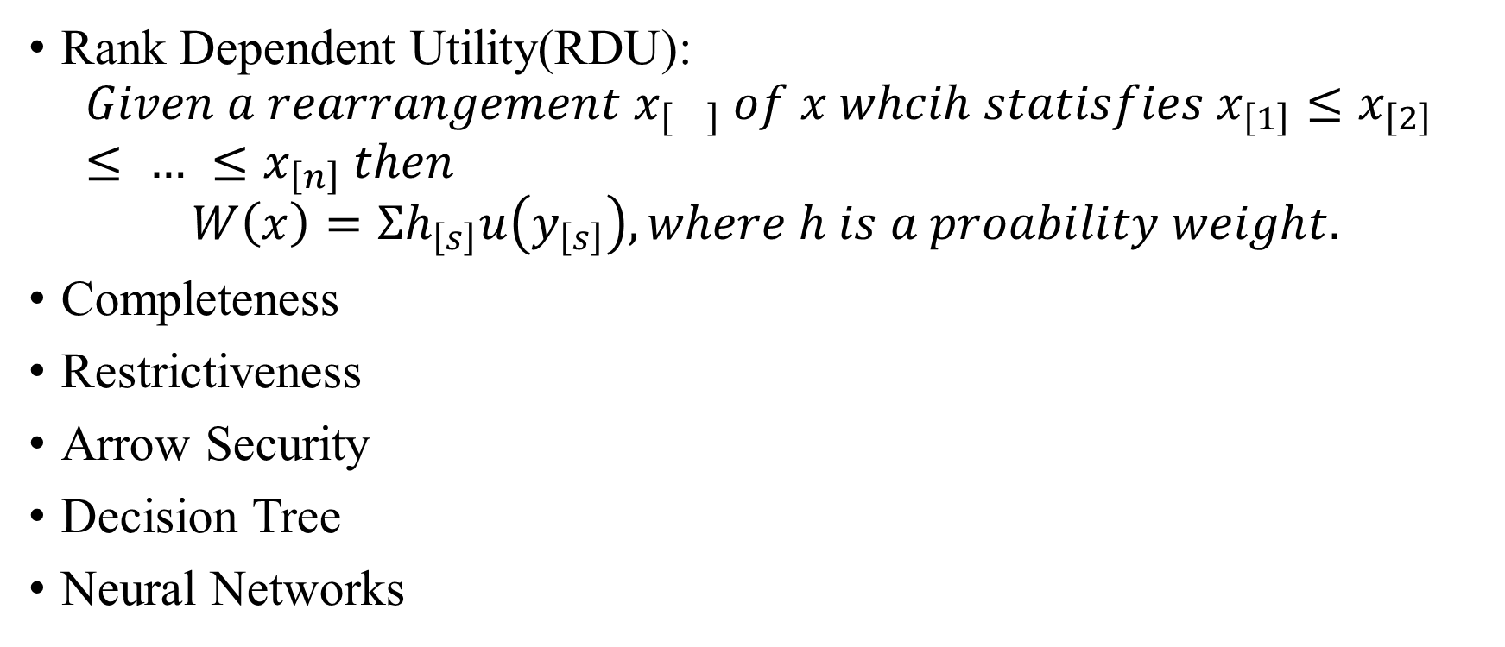
Preliminaries
Rank Dependent Utility(RDU):
$$Given a rearrangement x_{\left[\right]} of x whcih statisfies x_{\left[1\right]}≤x_{\left[2\right]}≤ … ≤x_{\left[n\right]} then$$
$$W\left(x\right)=Σh_{\left[s\right]}u\left(y_{\left[s\right]}\right), where h is a proability weight.$$
Completeness
Restrictiveness
Arrow Security
Decision Tree
Neural Networks

Slide 13
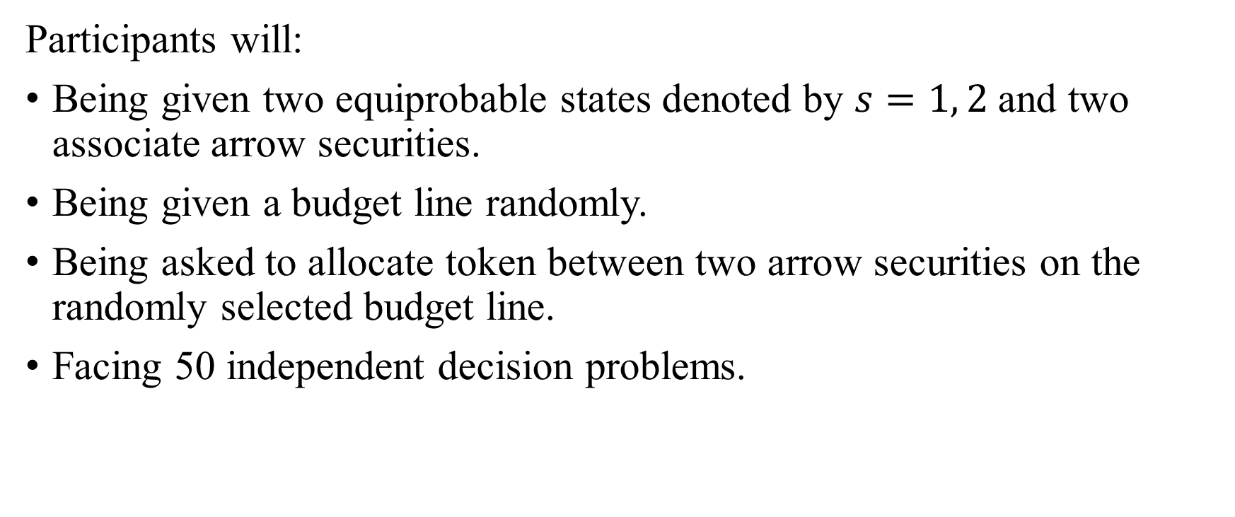
Experimental Design
Participants will:
Being given two equiprobable states denoted by $s=1, 2$and two associate arrow securities.
Being given a budget line randomly.
Being asked to allocate token between two arrow securities on the randomly selected budget line.
Facing 50 independent decision problems.

Slide 14
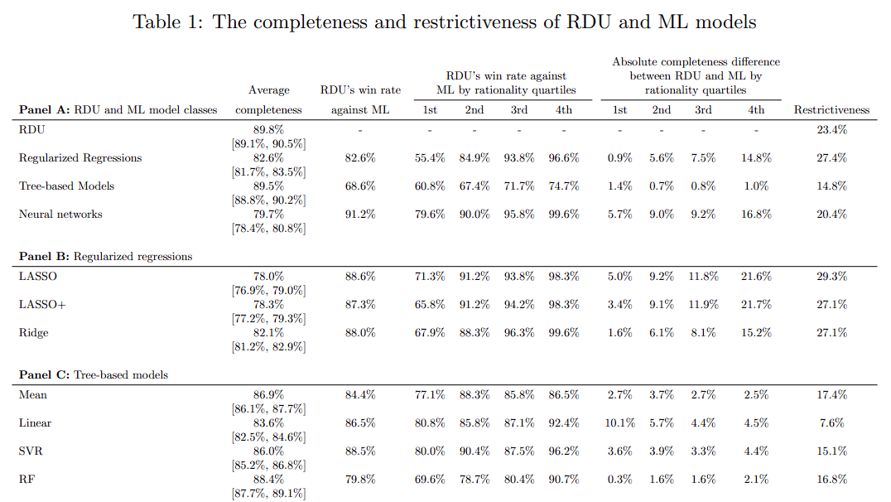
Results

Slide 15
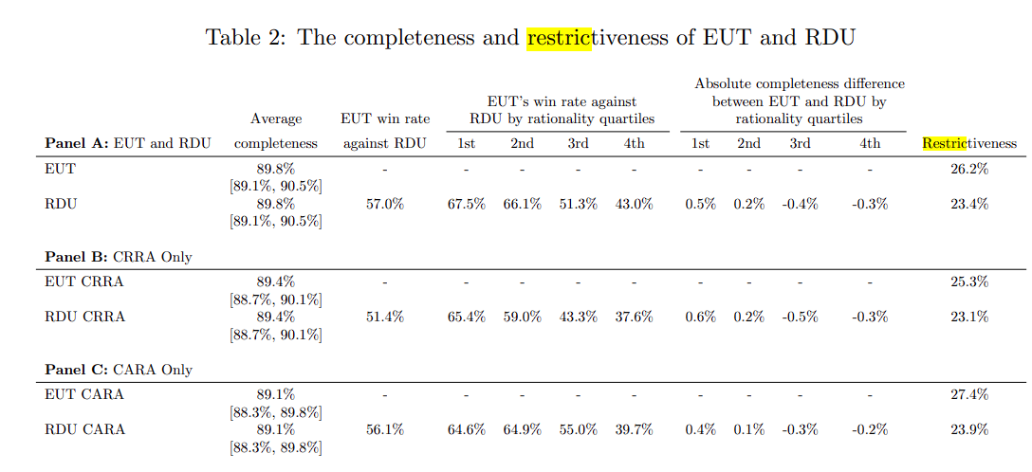
Results

Slide 16
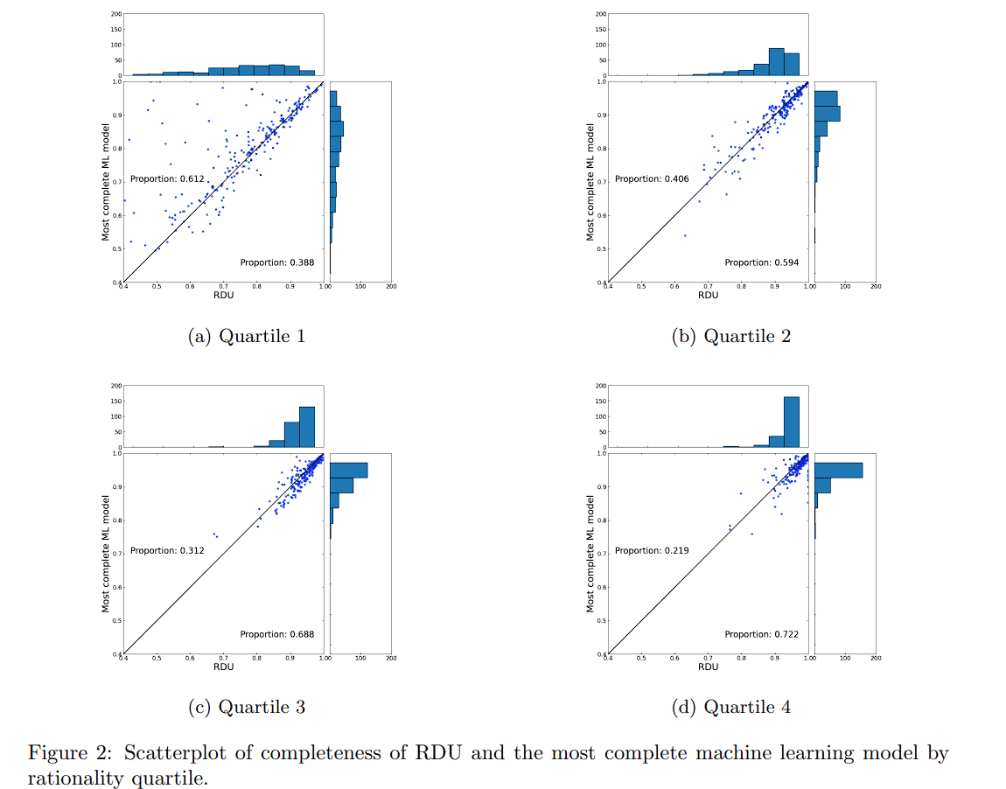
Results

